Slide 1


Slide 2
Content
Introduction
Formula
Type 1 problems: Combined average
General equation
Balance method
Type 2 problems: Change in average
General equation
Equal distribution method

Slide 3

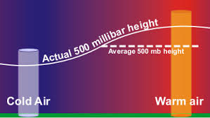
1) INTRODUCTION
What is an average ??
Average of n values is equal to the sum of n values divided by the total number of values (n)
Averages = Sum of Observations /Number of Observation
Avg = Sum/n

Slide 4
1.i Formula
Numbers | Sum | Average (Sum/n)
First n numbers | n(n+1)/2 | (n+1)/2
First n odd numbers | n^2 | n
First n even numbers | n(n+1) | (n+1)
First n square numbers | n(n+1)(2n+1)/6 | (n+1)(2n+1)/6
Consecutive numbers | n(first term + last term)/2 | (first term + last term)/2

Slide 5
Note: Average of consecutive numbers can also be written as
(2nd term + 2nd last term)/2 or (3rd term + 3rd last term)/2 and so on.
For odd number of consecutive values, the middle term will be the average.

Slide 6

Example 1.Find the average of following number
1, 3, 5, 7, 9, 11, 13, 15, 17, 19, 21
A) 9
B) 11
C) 12
D) 13

Slide 7

Example 2. The average of 20 numbers is zero. Of them, at the most, how many may be greater than zero?
A) 0
B) 1
C) 10
D) 19

Slide 8

Example 3. The average of 7 consecutive numbers is 20. The largest of these numbers is :
A)27
B)26
C)24
D)23

Slide 9
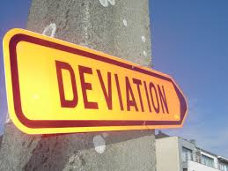
1.Ii DEVIATION METHOD
Example: Find the average of 20,23,28,24,25
Assume any number as the average, say 25.
Find the deviation for all the given values.
Numbers - 20 23 28 24 25
Deviation - -5 -2 +3 -1 0
Total deviation - -5
Average deviation - -5/5
(total/n) = -1
Final average = assumed average + average deviation
= 25 + (-1)
= 24

Slide 10
Note: It is better to assume the average between the highest value and the lowest value because it will always be between them.

Slide 11

Example 4. Find the Averages of 61,70,67,77,103,90
A)78
B)88
C)98
D)None
Notes:
Ans 78

Slide 12
2) TYPE 1 PROBLEMS
COMBINED AVERAGE
Class A
0
Class B
100
What is the combined average?
50 marks??
NO
We cannot determine the average without knowing the number of
students in each class
The combined average depends on the number of students and the average in each class

Slide 13

Example: There are 36 students in class A whose average is 30kg and 24 students in class B whose average is 40kg. What will be the average if the classes are combined?
2.i General equation
Avg₃₆= 30, Avg₂₄ = 40
Total weight of class A = 30 x 36
Total weight of class B = 40 x 24
Overall average = (Total weight of class A) + (Total weight of class B) / Number of students in class A + Number of students in class B
= (30 x 36) + (40 x 24) / 36 + 24
= 34

Slide 14

2.Ii BALANCE METHOD:
The principle of this concept is that the weight in the balance is inversely proportional to the distance of the pivot.
Where,
W_{a} – Class A weight W_{b} – Class B weight
Avg_{a} – Class A average Avg_{b} – Class B average
Avg_{c} – combined average
W_{a}
W_{b}
Avg_{a}
Avg_{c}
Avg_{b}

Slide 15
There are 36 students in class A whose average is 30kg and 24 students in class B whose average is 40kg. What will be the average if the classes are combined?
Step 1: Find the ratio of the weights of A and B
= 36:24
= 3:2
Step 2: Inverse the weights to get the distance ratio
= 2:3
36
3:2
24
30
40
36
3:2
24
30
2:3
40

Slide 16
Step 3: Split the distance between the averages in the ratio 2:3
Here the distance from 30 to 40 is 10. So 10 should be split in the ratio 2:3 as 4 and 6.
The combined average is (30+4) or (40-6) = 34
36
3:2
24
30
34
40
4
6
2:3

Slide 17
Note: Of these 5 values any one can be unknown which we have to find using the other 4 values.

Slide 18

Example 5. In class A there are 63 students whose average is 32, and in class B there are 21 students whose average is 44 , then find the overall average?
A)33
B)35
C)36
D)38

Slide 19
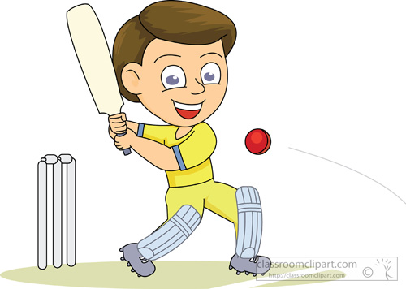
Example 6. In a first 10 overs cricket game run rate was 3.2. what should be run rate in the remaining 40 overs to reach the target 282 runs?
A)6.25
B)6.5
C)6.75
D)7

Slide 20

3) TYPE 2 PROBLEMS
Change in average
Example: Average of 5 students marks is 30. If one student having 90 mark is added to the team then what will be the new average ?
3.i General equation
Avg₅ = 30
No of students = 5
Sum₅ = 30x5
= 150
Sum₆ = 150+90
= 240
Avg₆ = 240/6
= 40

Slide 21
3.Ii EQUAL DISTRIBUTION method:
All the problems in this concept are solved by assuming all the values as average itself.
Step1: Assume all the values to be 30.
30 30 30 30 30
If the new mark is also 30 then the average will remain the same.
30 30 30 30 30
Step2: Finding the extra values-
But the actual new mark is 90, which means extra 60 is added to the values.
30 30 30 30 30
90
30
30
+60

Slide 22
Step3: Distributing the extra values equally-
The extra 60 should be divided equally among 6 values as 10 each.
30 30 30 30 30 30
+10 +10 +10 +10 +10 +10
40 40 40 40 40 40
∴ the new average is 40

Slide 23

Example 7. Average of 4 students marks is 50 and one student having marks has 200, is added to the team , what is new average ?
A)70
B)80
C)90
D)None

Slide 24

Example 8. Average of 6 students marks is 60 , what is the new average if a student of marks 110 is taken out ?
A50
B)55
C)60
D)None

Slide 25
*If the number of values is unknown:
Avg_{n} = 30
Avg_{n+1} = 40
New number= 90
Old values 30 30 30…….
+10 +10 +10……
New values 40 40 40…….
Total extra value added is 60 (30 90)
This 60 is divided as 10 each which means there should be 60/10 = 6 values
∴ New values, n+1 = 6
Old values, n = 5

Slide 26
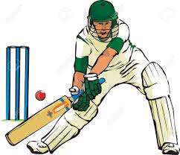
Example 9. A batsman having average 40 makes 90 runs in his last inning thereby his average increases by 2. Find the number of matches he has played.
A)10
B)50
C)25
D)24

Slide 27
*If the average is unknown:
Avg₅ = x
Avg₆ = x+10
New number= 90
Old values x x x x x
New values x+10 x+10 x+10 x+10 x+10 x+10
Total extra value added is 60 (6 x 10)
This 60 is being increased because of the new number 90 which means the initial value has to be 30.
∴ Avg₅, x = 30
Avg₆, x+10 = 40
x
+10 +10 +10 +10 +10 +10
New number

Slide 28
Example 10. The average marks of 12 students increases by 3 if a new student having mark 79 is included. The average mark of the students is?
A) 37
B) 40
C) 43
D) 82

Slide 29
*If the new number is unknown:
Avg₅ = 30
Avg₆ = 40
New number= ?
Old values 30 30 30 30 30
New values 40 40 40 40 40 40
Total extra value added is 60 (6x10)
Already the number has to be 30 to maintain the average.
∴ the new number should be 30 + 60 = 90
30
+10 +10 +10 +10 +10 +10
New number

Slide 30

Example 11. The average weight of 8 men having average weight 40 kg is increased by 2 kg when a new man is included. The weight of the new man is
A) 56
B) 58
C) 96
D) 98

Slide 31
When one or more than one new items are added
Let Average of N items is ‘A’, now say ‘n’ new item is added and average increased or decreased by x, then
Average of New items added= A +/-[1+N/n]x

Slide 32
When one or more than one new items are removed
Let Average of N items is ‘A’, now say ‘n’ new item is added and average increased or decreased by x, then
Average of New items removed= A +/-[1-N/n]x

Slide 33
Example 12. The Average age of 40 Students in a class is 15 years. When 10 new students are admitted, the average increases by 0.2 per year. Find the average age of new students
A.15 years
B.16 years
C.17 years
D.18 years

Slide 34
Example 13. The Average salary of 15 teachers is Rs 4500 per month. When 3 teachers left the school , the average salary of remaining teachers dropped by Rs 175. Find the total salary of those teachers who left the school.
A.15,500
B.15,600
C.15,700
D.16000

Slide 35


